Slide 1


Slide 2
Data Structures & Algorithms
Zach Merrill, Systems App Developer - Gallup
James Getrost, Systems App Developer Intern - Gallup

Slide 3
Agenda
Data Structures
Java Arrays & Collections
Computational Complexity
Sorting Algorithms
Eclipse Demo

Slide 4
DATA STRUCTURES
Data Structures & Algorithms

Slide 5
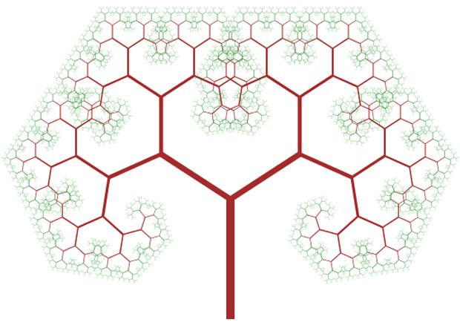
DATA STRUCTURES
Data structures are used to organize data for efficient access
Referred to as Abstract Data Types (ADTs)
Some structures have very broad use cases, others are specialized
Lists, Stacks, Queues and Trees

Slide 6
DATA STRUCTURES - Lists
Most list come in one of two flavors: Array or Linked
Array lists are stored in contiguous memory
Array lists offer quick access to stored elements, but are slow to insert and delete anywhere but the end
Linked lists are not stored in contiguous memory; instead they contain the address of the next node
Linked lists sacrifice some of the access time for quick inserts and deletes

Slide 7
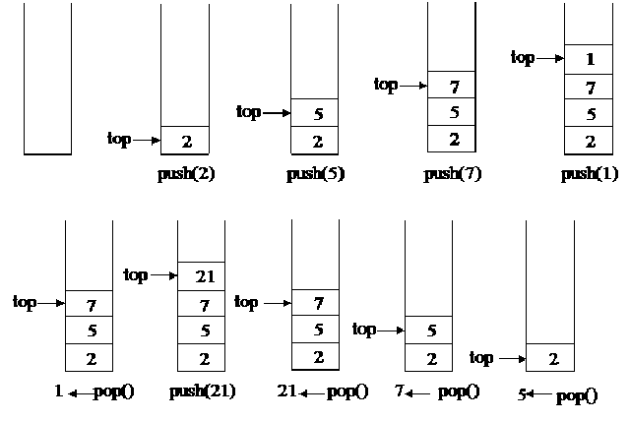
Data Structures - Stacks
A stack is a list with the restriction that inserts and deletes can only occur at the end or top of the list
Only the top is accessible
Two operations: push and pop
Last In First Out (LIFO)
What are some use cases?

Slide 8
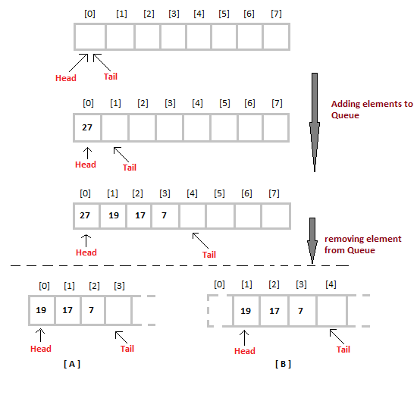
Data Structures – Queues
A queue is a list where inserts are restricted to one side and deletes are restricted to the other
Two operations: enqueue and dequeue
First In First Out (FIFO)
What are some use cases?

Slide 9
Data Structures – Trees
A tree is a collection of nodes
There is one root node
The root connects to zero or more nodes
Each of those nodes can be considered to be a root of a subtree

Slide 10
Data Structures – Trees
Nodes with no children are called leaves
A path is a sequence of nodes
A path has a length
The depth of a node is the length from it to the root
The height of a node is the greatest depth

Slide 11
Data Structures – Trees
A tree node contains links to all of its children
How would you implement that?
What are some use cases?

Slide 12
JAVA ARRAYS & COLLECTIONS
Data Structures & Algorithms

Slide 13
Java Arrays
A Java array can be of any type, but is fixed in size from the moment of creation
Public class ArrayDemo {
public static void main(String[] args) {
// declares an array of integers
int[] anArray;
// allocates memory for 10 integers
anArray = new int[10];
// initialize first element anArray[0] = 100;
// initialize second element anArray[1] = 200;
// and so forth
…
}
}

Slide 14
Java Arrays
There are initialization shortcuts
int[] anArray = { 100, 200, 300, 400, 500};

Slide 15
Java Arrays
And multidimensional arrays
Public class MultiDimArrayDemo {
public static void main(String[] args) {
String[][] names = { {"Mr. ", "Mrs. ", "Ms. "}, {"Smith", "Jones"} };
// Mr. Smith
System.out.println(names[0][0] + names[1][0]);
// Ms. Jones
System.out.println(names[0][2] + names[1][1]);
}
}

Slide 16
Java Arrays
Lets look at the Arrays utility class

Slide 17
Java Collections
Java provides us with the Collection interface
Collection is a generic type, which means we can define what type of object it will hold
The Collection framework has a large number of data structures implemented and ready to use
Import from java.util
Lets take a look

Slide 18
COMPUTATIONAL COMPLEXITY
Data Structures & Algorithms

Slide 19
COMPUTATIONAL COMPLEXITY
An algorithm is a set of operations that are performed to solve a problem
Algorithms may take some values as input, and the must eventually stop and return a result in some form
Elegant algorithms are less verbose
Good algorithms are faster
Just because you write less code, doesn’t mean your code is faster!

Slide 20
COMPUTATIONAL COMPLEXITY
Developers should be very concerned with the time and resources it takes for their algorithm to solve a problem
In general we are concerned with the worst case
We can use discrete mathematics – Big O notation
How long will the algorithm take as the input grows toward infinity?

Slide 21
COMPUTATIONAL COMPLEXITY
O(1) – constant time
O(log n) – logarithmic time
O(n) – linear time
O(n log n)
O(n²) – quadratic time
O(n!) – factorial time

Slide 22
COMPUTATIONAL COMPLEXITY
public void doSomething (int n){
int[] a = new int[1];
a[0] = n;
}

Slide 23
COMPUTATIONAL COMPLEXITY
public void doSomething (int n){
for(i = 0; i < n; i++){
doSomethingElse(i);
}
}

Slide 24
COMPUTATIONAL COMPLEXITY
public void doSomething (int n){
for(i = 0; i < n; i++){
for(j = 0; j < n; j++){
doSomethingElse(i,j);
}
}
}

Slide 25
COMPUTATIONAL COMPLEXITY
public void doSomething (int n){
for(i = 0; i < n; i++){
for(j = i; j < n; j++){
doSomethingElse(i,j);
}
}
}

Slide 26
SORTING ALGORITHMS
Data Structures & Algorithms

Slide 27
Insertion Sort
O(n²)
For each element in the list
Compare that element to each previous element
until the previous element is less than or equal to
the current element

Slide 28
Bubble Sort
O(n²)
While the list is unsorted
For each element in the list
Compare adjacent pairs and switch positions if
the left element is greater than the right element

Slide 29
Selection Sort
O(n²)
Divide the list into two parts
sorted || unsorted
While unsorted is not empty
Scan unsorted list for smallest
element
Append it to the end of the sorted
list

Slide 30
ECLIPSE DEMO
Data Structures & Algorithms

Slide 31
Summary
Data Structures
Java Arrays & Collections
Computational Complexity
Sorting Algorithms
Eclipse Demo

